Slide 1
UNIT - II

Slide 2
One-Dimensional Arrays
A list of values with the same data type that are stored using a single group name (array name).
General array declaration statement:
data-type array-name[number-of-items];
The number-of-items must be specified before declaring the array.
int SIZE = 100;
float arr[SIZE];
Individual elements of the array can be accessed by specifying the name of the array and the element's index:
arr[3]

Slide 3
One-Dimensional Arrays (cont.)
The array name arr identifies the starting location of the array
arr[0] | arr[1] | arr[2] | arr[3] | arr[4]

Slide 4
Two-dimensional Arrays
A two-dimensional array consists of both rows and columns of elements.
General array declaration statement:
data-type array-name[number-of-rows][number-of-columns];
The number-of-rows and number-of-columns must be specified before declaring the array.
const int ROWS = 100;
const int COLS = 50;
float arr2D[ROWS][COLS];

Slide 5
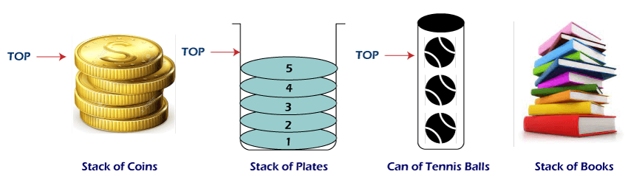
What is a stack?
It is an ordered group of homogeneous items of elements.
Elements are added to and removed from the top of the stack (the most recently added items are at the top of the stack).
The last element to be added is the first to be removed (LIFO: Last In, First Out).

Slide 6
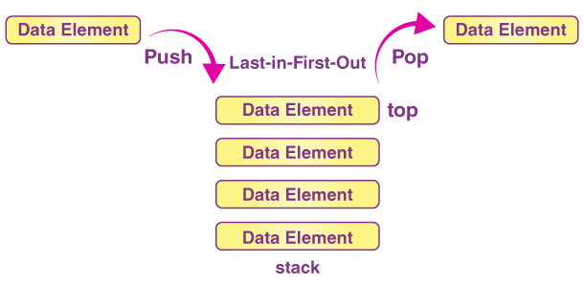
Stack Specification
Definitions: (provided by the user)
MAX_ITEMS: Max number of items that might be on the stack
ItemType: Data type of the items on the stack
Operations
MakeEmpty
Boolean IsEmpty
Boolean IsFull
Push (ItemType newItem)
Pop (ItemType& item)

Slide 7
Push
Function: Adds new Item to the top of the stack.
Preconditions: Stack has been initialized and is not full.
Postconditions: new Item is at the top of the stack.
Algorithm:
Step-1: If TOP = Max-1
Print “Overflow”
Goto Step 4
Step-2: Set TOP= TOP + 1
Step-3: Set Stack[TOP]= ELEMENT
Step-4: END

Slide 8
Pop
Function: Removes top Item from stack and returns it in item.
Preconditions: Stack has been initialized and is not empty.
Postconditions: Top element has been removed from stack.
Algorithm:
Step-1: If TOP= NULL
Print “Underflow”
Goto Step 4
Step-2: Set VAL= Stack[TOP]
Step-3: Set TOP= TOP-1
Step-4: END

Slide 9
Stack overflow
The condition resulting from trying to push an element onto a full stack.
if(!stack.IsFull())
stack.Push(item);
Stack underflow
The condition resulting from trying to pop an empty stack.
if (!stack.IsEmpty())
stack.Pop(item);

Slide 10
Applications of Stack
Evaluation of Arithmetic Expressions
Backtracking
Delimiter Checking
Reverse a Data
Processing Function Calls

Slide 11
Evaluation of Arithmetic Expressions
Evaluation of Arithmetic Expression requires two steps:
First, convert the given expression into special notation.
Evaluate the expression in this new notation.
Notations for Arithmetic Expression
There are three notations to represent an arithmetic expression:
Infix Notation
Prefix Notation
Postfix Notation

Slide 12
Evaluation of Arithmetic Expressions
Infix Notation
The infix notation is a convenient way of writing an expression in which each operator is placed between the operands.
Example: A + B, (C - D) etc.
Prefix Notation
The prefix notation places the operator before the operands. This notation was introduced by the Polish mathematician and hence often referred to as polish notation.
Example: + A B, -CD etc.
Postfix Notation
The postfix notation places the operator after the operands. This notation is just the reverse of Polish notation and also known as Reverse Polish notation.
Example: AB +, CD+, etc.

Slide 13
Conversion of Arithmetic Expression into various Notations
Operator Priority
Infix Notation | Prefix Notation | Postfix Notation
A * B | * A B | AB*
(A+B)/C | /+ ABC | AB+C/
(A*B) + (D-C) | +*AB - DC | AB*DC-+
Operators | Associativity
^ exponentiation | Right to left
*Multiplication, /division | Left to right
+ addition, - subtraction | Left to right

Slide 14
Conversion of Arithmetic Expression into Postfix Notations
Conversion Rules:
No two operator with same priority stayed in stack
Highest priority can’t be placed before lowest priority.
Always pop the operator inside the ( );
Example : A+B * (C+D)/F+D*E
Postfix ABCD+*F/+DE*+

Slide 15
Postfix Notations Evaluation using Stack
Conversion Rules:
Empty the stack
Read the single character a time
If it’s a number push into stack
If it’s a operator pop last two elements and operate using the operator and push the result into the stack.
Input: 6 5 2 3 + 8 * + 3 -
Result : 39

Slide 16
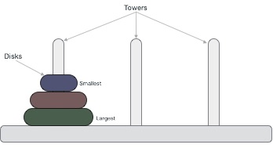
Tower of Hanoi
Tower of Hanoi, is a mathematical puzzle which consists of three towers (pegs) and more than one rings is as depicted
These rings are of different sizes and stacked upon in an ascending order, i.e. the smaller one sits over the larger one. There are other variations of the puzzle where the number of disks increase, but the tower count remains the same.

Slide 17
Tower of Hanoi
Rules:
The mission is to move all the disks to some another tower without violating the sequence of arrangement.
Only one disk can be moved among the towers at any given time.
Only the "top" disk can be removed.
No large disk can sit over a small disk.
Tower of Hanoi puzzle with n disks can be solved in minimum 2^{n}−1 steps. This presentation shows that a puzzle with 3 disks has taken 2³ - 1 = 7 steps

Slide 18
Tower of Hanoi Algorithm
Algorithm:
Step 1 − Move n-1 disks from source to aux
Step 2 − Move nth disk from source to destination
Step 3 − Move n-1 disks from aux to destination
START
Procedure Hanoi(disk, source, dest, aux)
IF disk == 1, THEN
move disk from source to dest
ELSE
Hanoi(disk - 1, source, aux, dest) // Step 1
move disk from source to dest // Step 2
Hanoi(disk - 1, aux, dest, source) // Step 3
END IF
END Procedure
STOP

Slide 19
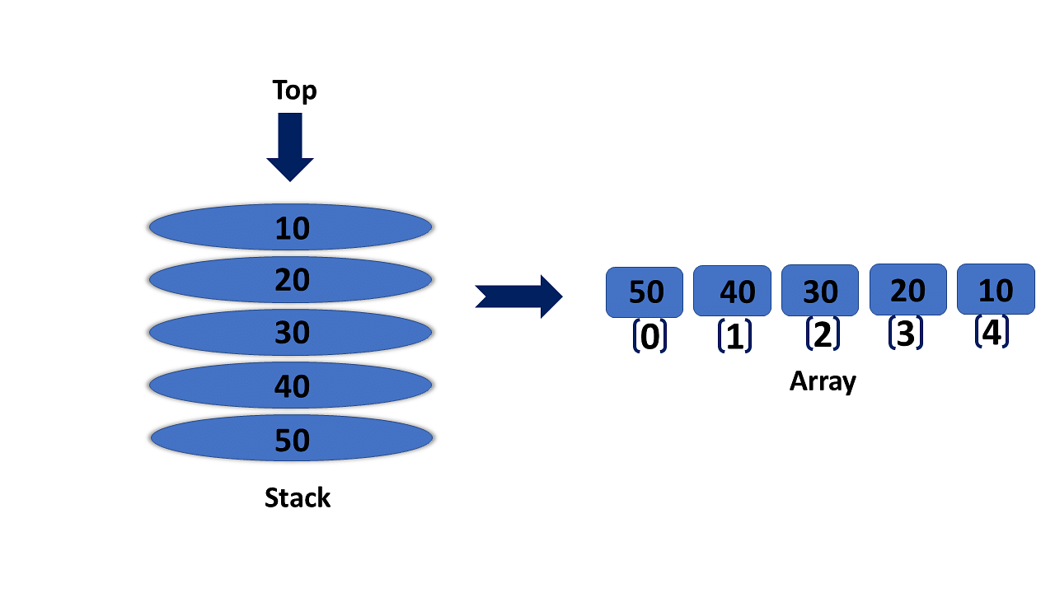
Array based Stacks
It forms the stack for Stack implementation using arrays.
All the stack operations can be done.

Slide 20
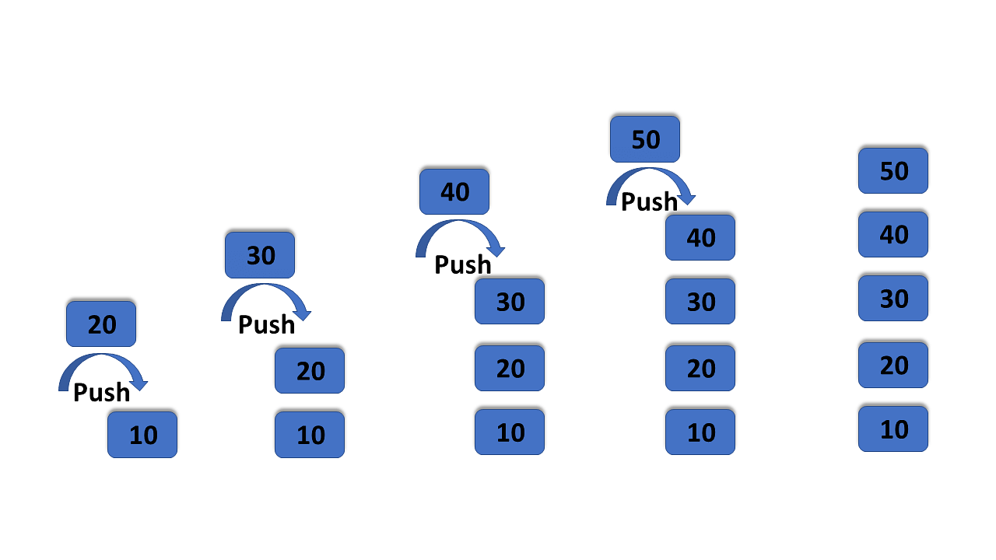
Push Operation
Increment the top variable of the stack so that it can refer to the next memory location.
Add a data element at the increment top position.
If top = n
stack is full
Else
top = top + 1
stack(top) = data
end

Slide 21
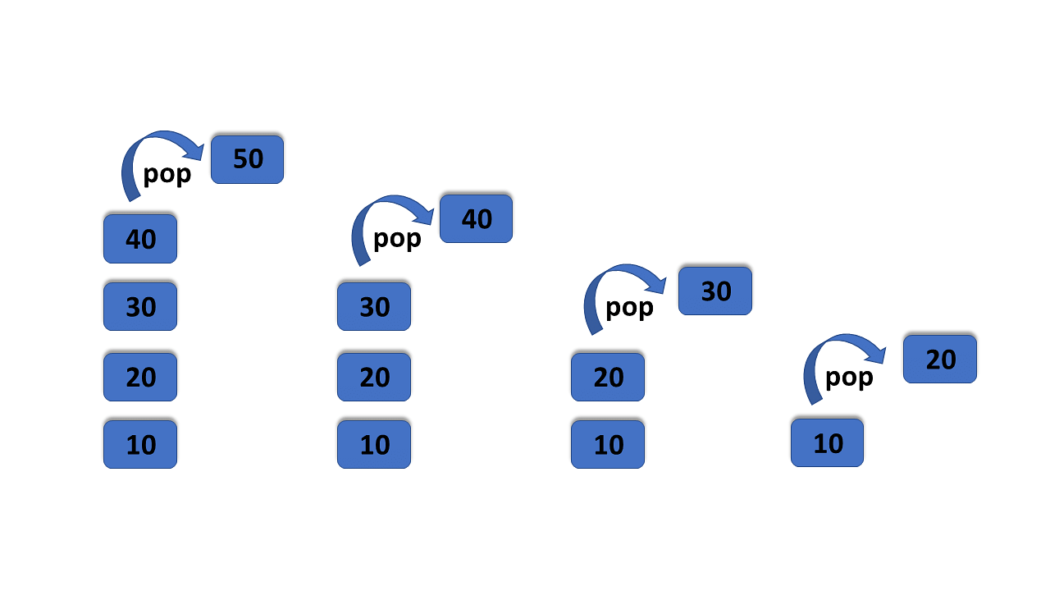
Pop Operation
The value of the top variable will be incremented by one whenever you delete an item from the stack
Begin
if top = 0
stack is empty
else
value = stack(top)
top= =top -1
end

Slide 22
Linked Stacks
The main advantage of using a linked list over arrays is that it is possible to implement a stack that can shrink or grow as much as needed.
Using an array will put a restriction on the maximum capacity of the array which can lead to stack overflow. Here each new node will be dynamically allocated. so overflow is not possible.
Stack Operations:
push(): Insert a new element into the stack i.e just insert a new element at the beginning of the linked list.
pop(): Return the top element of the Stack i.e simply delete the first element from the linked list.
peek(): Return the top element.
display(): Print all elements in Stack

Slide 23
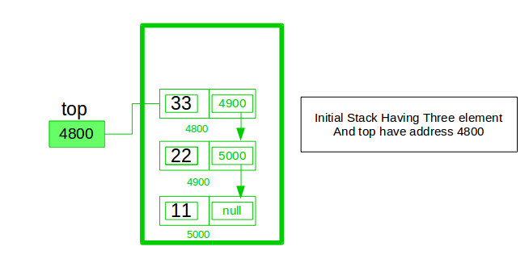
Linked Stacks
Need to follow a simple rule in the implementation of a stack which is last in first out and all the operations can be performed with the help of a top variable. Let us learn how to perform Pop, Push, Peek, and Display operations
4900

Slide 24
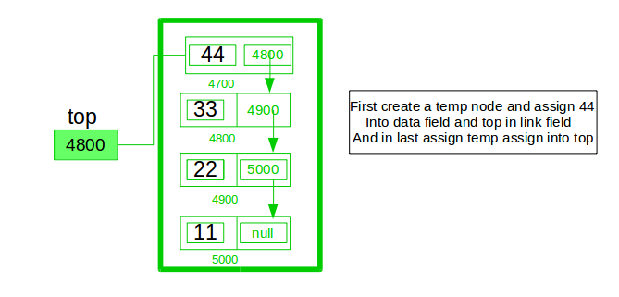
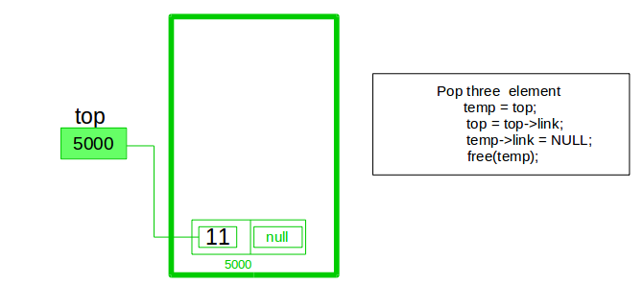
Linked Stacks

Slide 25
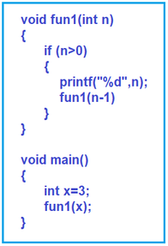
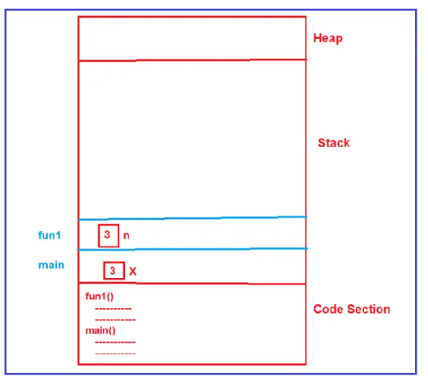
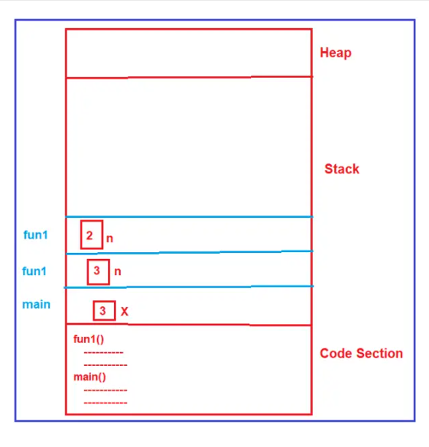
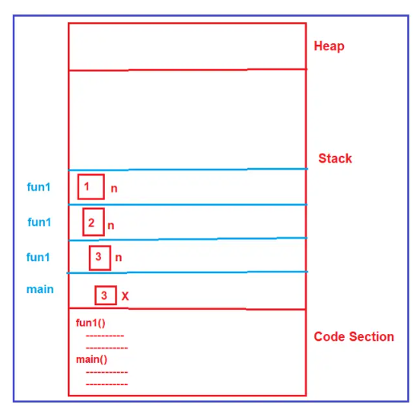
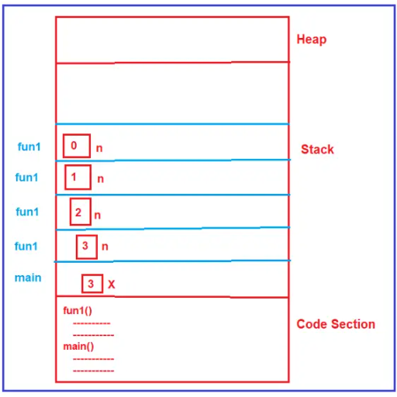
Recursion using Stacks

Slide 26
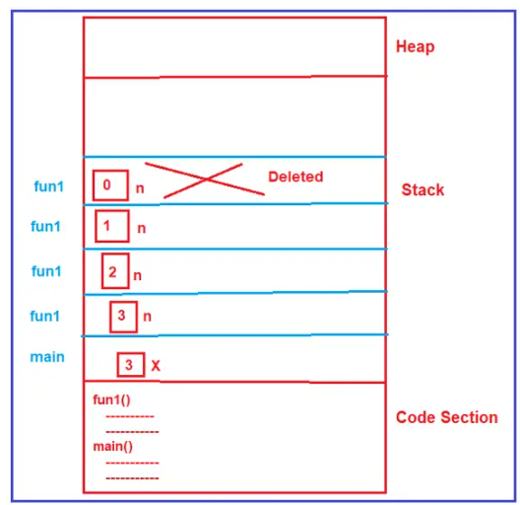
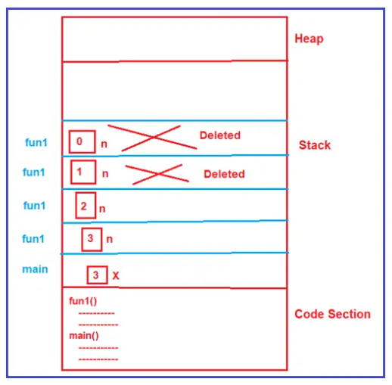
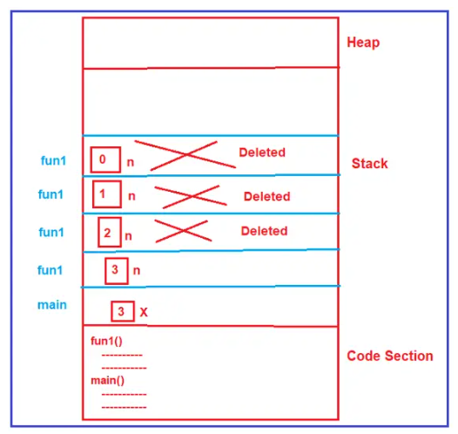
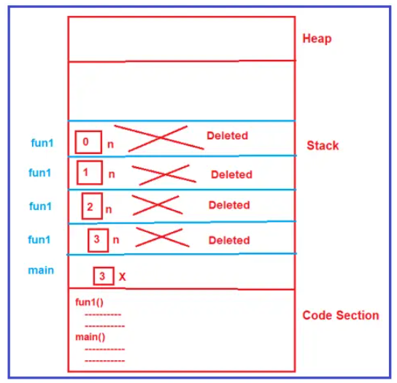
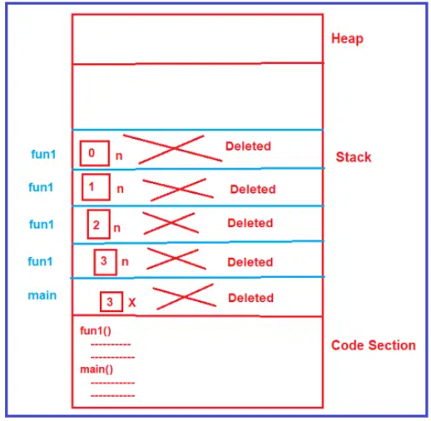
Recursion using Stacks

Slide 27

Queue
It is an ordered group of homogeneous items of elements.
Queues have two ends:
Elements are added at one end.
Elements are removed from the other end.
The element added first is also removed first (FIFO: First In, First Out).

Slide 28
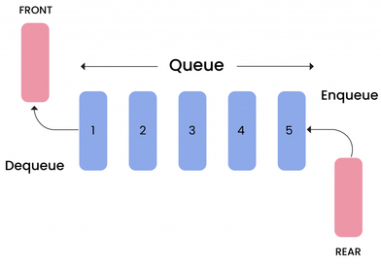
Queue Specification
Definitions: (provided by the user)
MAX_ITEMS: Max number of items that might be on the queue
ItemType: Data type of the items on the queue
Operations
MakeEmpty
BooleanA IsEmpty
Boolean IsFull
Enqueue (ItemType newItem)
Dequeue (ItemType& item)

Slide 29
Enqueue
Function: Adds newItem to the rear of the queue.
Preconditions: Queue has been initialized and is not full.
Postconditions: newItem is at rear of queue.
Algorithm
START
Check if the queue is full.
If the queue is full, produce overflow error and exit.
If the queue is not full, increment rear pointer to point the next empty space.
Add data element to the queue location, where the rear is pointing.
return success.
END

Slide 30
Dequeue
Function: Removes front item from queue and returns it in item.
Preconditions: Queue has been initialized and is not empty.
Postconditions: Front element has been removed from queue.
Algorithm
START
Check if the queue is empty.
If the queue is empty, produce underflow error and exit.
If the queue is not empty, access the data where front is pointing.
Increment front pointer to point to the next available data element.
Return success.
END

Slide 31
Queue overflow
The condition resulting from trying to add an element onto a full queue.
if(!q.IsFull())
q.Enqueue(item);
Algorithm for IsFull
START
If the count of queue elements equals the queue size, return true
Otherwise, return false
END

Slide 32
Queue underflow
The condition resulting from trying to remove an element from an empty queue.
if(!q.IsEmpty())
q.Dequeue(item);
Algorithm for IsEmpty
START
If the count of queue elements equals zero, return true
Otherwise, return false
END

Slide 33
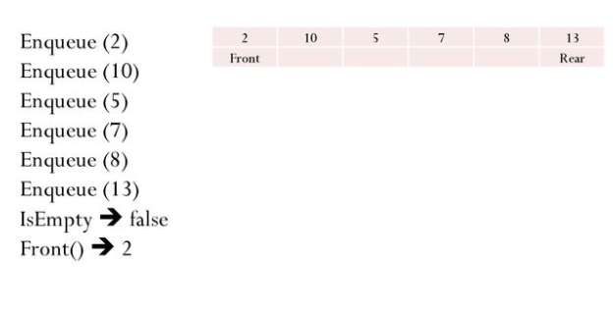
Example

Slide 34
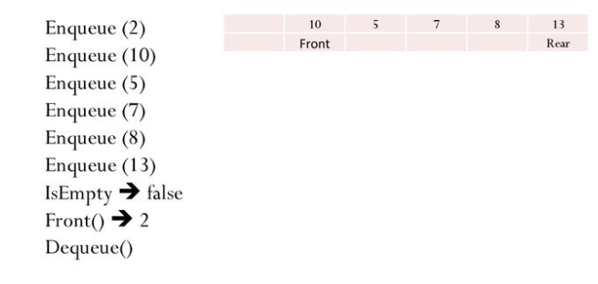
Example

Slide 35
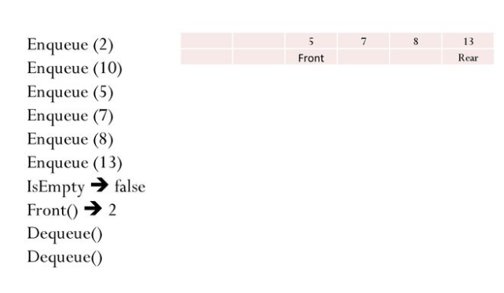
Example

Slide 36
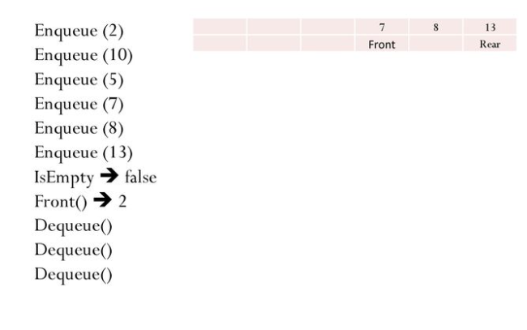
Example

Slide 37
Array Based Queue
The queue is a linear collection of distinct entities like an array.
Queue possesses some restrictions while performing insertion and deletion.
In the case of a queue, it can perform both insertion and deletion only at specific ends, i.e., rear and front nodes.
Whereas arrays do not follow any order for these operations.

Slide 38
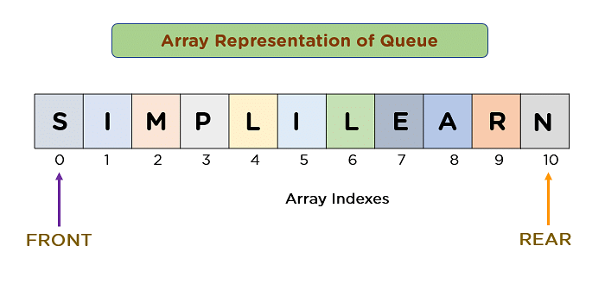
Array Based Queue
The array shown in the diagram below consists of 11 characters having S at the front and N at the rear node.

Slide 39
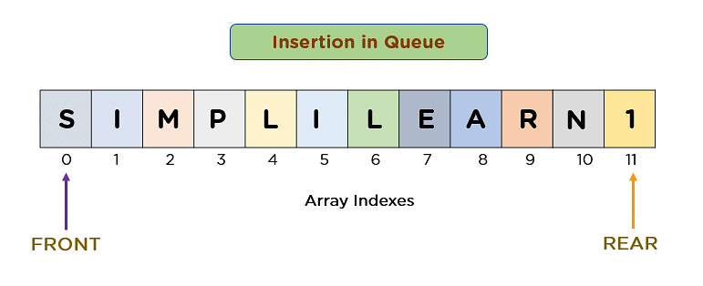
Array Based Queue
The value of the rear pointer becomes 11, whereas the front pointer remains the same

Slide 40
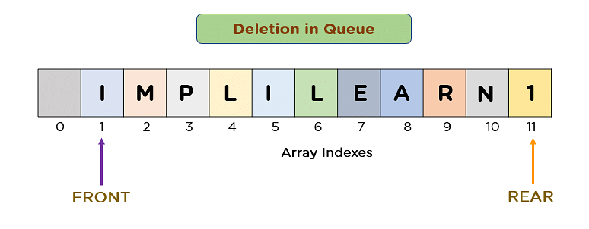
Array Based Queue
After deleting an element from the queue, the value of the front pointer will change from 0 to 1.

Slide 41
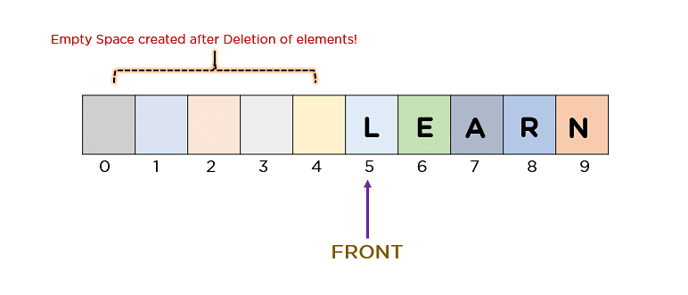
Drawbacks of Array based Queue
Memory Wastage
The size of the queue is 10, and the front pointer has already reached location 5, thus wasting newly created empty spaces.
Deciding the array size
User can extend the queue at the runtime depending upon the problem.
It is almost impossible to extend an array size at runtime.

Slide 42
Linked Queue
In a linked queue, each node of the queue consists of two fields, i.e., data field and reference field.
Each entity of the linked queue points to its immediate next entity in the memory.
Two pointers are preserved in the memory to keep track of the front and rear node.
The first pointer stores the location where the queue starts, and another pointer keeps track of the last data element of a queue.

Slide 43
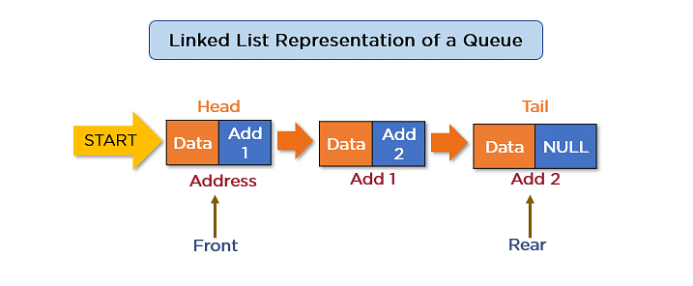
Linked Queue
The diagram consists of a linked list representation of queue comprising 3 data fields and addresses of the subsequent entities in a queue.

Slide 44
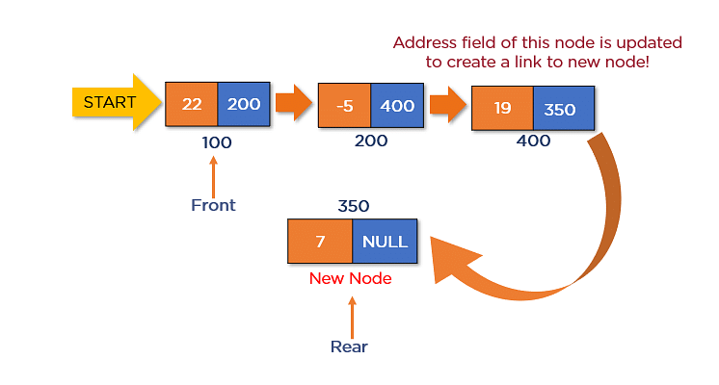
Linked Queue
Enqueue() Operation
insert a new node located at address 350 and consisting 7 in its data field. For that to happen, just update the value of the rear pointer and address field of the previous node.

Slide 45
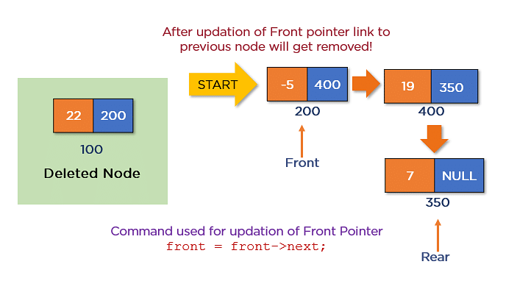
Linked Queue
Dequeue() Operation
After deleting an element from the linked queue, the value of the front pointer will change from 100 to 200.

Slide 46
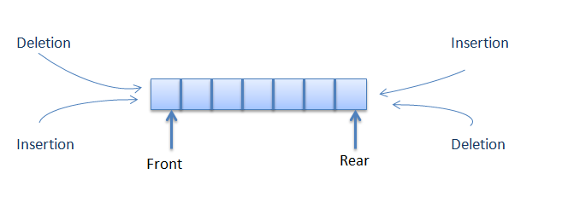
Double Ended Queue
A double-ended queue is an abstract data type similar to an simple queue.
It allows you to insert and delete from both sides means items can be added or deleted from the front or rear end.

Slide 47
Insertion at rear end
Step -1: [Check for overflow]
if(rear==MAX)
Print("Queue is Overflow”);
return;
Step-2: [Insert element]
else
rear=rear+1;
q[rear]=no;
[Set rear and front pointer]
if rear=0
rear=1;
if front=0
front=1;
Step-3: return

Slide 48
Insertion at front end
Step-1 : [Check for the front position]
if(front<=0)
Print (“Cannot add item at front end”);
return;
Step-2 : [Insert at front]
else
front=front-1;
q[front]=no;
Step-3 : Return

Slide 49
Deletion at front end
Step-1 [ Check for front pointer]
if front=0
print(" Queue is Underflow”);
return;
Step-2 [Perform deletion]
else
no=q[front];
print(“Deleted element is”, no);
[Set front and rear pointer]
if front=rear
front=0;
rear=0;
else
front=front+1;
Step-3 : Return

Slide 50
Deletion at rear end
Step-1 : [Check for the rear pointer]
if rear=0
print(“Cannot delete value at rear end”);
return;
Step-2: [ perform deletion]
else
no=q[rear];
[Check for the front and rear pointer]
if front= rear
front=0;
rear=0;
else
rear=rear-1;
print(“Deleted element is”,no);
Step-3 : Return

Slide 51
Circular Queue
A circular queue is an extended version of a linear queue
It follows the First In First Out principle with the exception that it connects the last node of a queue to its first by forming a circular link.
it is also called a Ring Buffer.

Slide 52
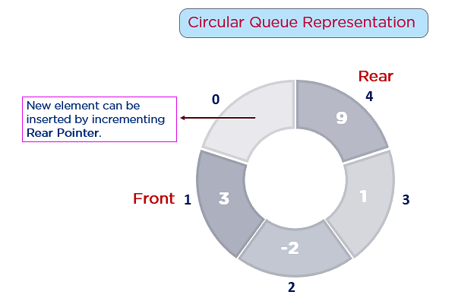
Circular Queue
Front - Used to get the starting element of the Circular Queue.
Rear - Used to get the end element of the Circular Queue.
enQueue(value) - Used to insert a new value in the Circular Queue. This operation takes place from the end of the Queue.
deQueue() - Used to delete a value from the Circular Queue. This operation takes place from the front of the Queue.

Slide 53
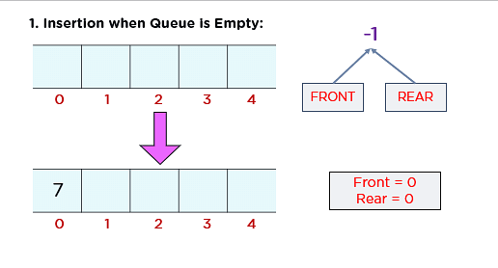
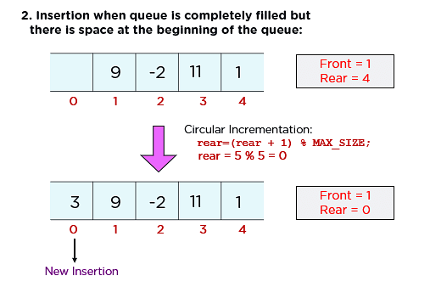
Insertion in Circular Queue

Slide 54
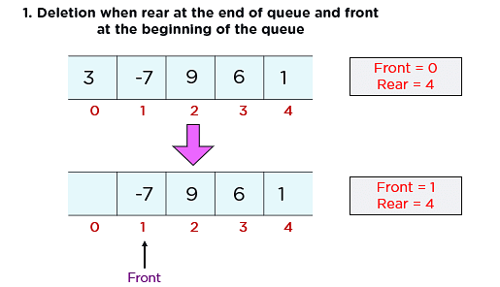
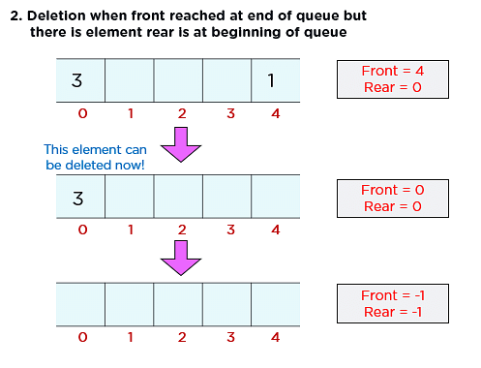
Deletion in Circular Queue

